Slide 1




PRESENTATION ON
Employee management system
PRESENTED BY :
GREESHMA
SOWMYA
SANGEETHA

Slide 2

EMPLOYEE MANAGEMENT
SYSTEM

Slide 3

INTRODUCTION
This dataset represents a comprehensive Employee Management System covering 60 employees across multiple departments. It includes detailed employee demographics, job roles, qualifications, and contact information. The dataset also captures job structures, salary details, payroll records, and bonus information, enabling complete compensation analysis. Additionally, it tracks employee leave history with reasons and dates for effective attendance monitoring. Overall, this dataset is suitable for HR analytics, payroll processing, workforce planning, and organizational performance analysis.

Slide 4
OBJECTIVE OF THE PROJECT
To develop a centralized employee management system using structured organizational data.
To manage and analyze employee details, job roles, departments, and qualifications efficiently.
To track payroll, salary structures, bonuses, and monthly payment records accurately.
To monitor employee leave details and identify attendance patterns.
To support HR and management with data-driven insights for better decision-making.

Slide 5
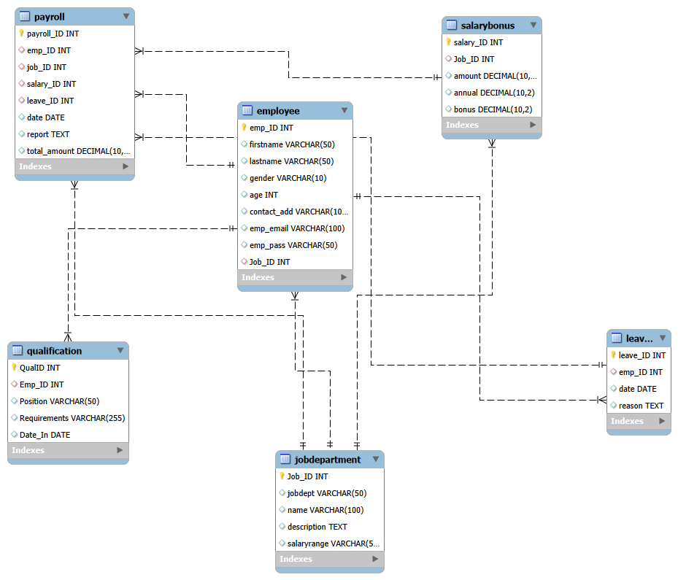
ER DIAGRAM

Slide 6
ER DIAGRAM EXPLANATION
1. JobDepartment
Relationship: Many-to-One
Multiple employees can belong to the same job/department, but each employee is assigned to only one job.
Linked using Job_ID as a foreign key in the Employee table.
2. Payroll
Relationship: One-to-Many
An employee can have multiple payroll records (monthly payrolls), but each payroll record belongs to one employee.
Linked using Emp_ID as a foreign key in the Payroll table.
3. Leave
Relationship: One-to-Many
An employee can apply for multiple leaves, but each leave record is associated with a single employee.
Linked using Emp_ID as a foreign key in the Leave table.

Slide 7
ER DIAGRAM EXPLANATION
4. Employee – Qualification
Relationship: One-to-Many
An employee can have multiple qualifications recorded, but each qualification belongs to one employee.
Linked using Emp_ID as a foreign key in the Qualification table.
5. JobDepartment – SalaryBonus
Relationship: One-to-One / One-to-Many (based on design)
Each job role has a defined salary structure, and a department can have multiple salary records if needed.
Linked using Job_ID as a foreign key in the SalaryBonus table.
6. Payroll – SalaryBonus
Relationship: Many-to-One
Multiple payroll entries can reference the same salary structure for calculation.
Linked using Salary_ID as a foreign key in the Payroll table.
7. Payroll – Leave
Relationship: One-to-One / Optional
Payroll may consider leave details while calculating salary for a given period.
Linked using Leave_ID as a foreign key in the Payroll table.

Slide 8
PROBLEM STATEMENT
The objective of this project is to design and implement an Employee Management System that efficiently stores and manages employee-related data within an organization. The system needs to track various aspects of employee information, including personal details, job roles, salary structures, qualifications, leave records, and payroll data. The system should ensure the integrity and consistency of data by using relational tables with appropriate foreign keys and cascading actions.
The system should allow for easy management and querying of employee data, providing insights such as payroll calculation, leave tracking, and department-specific job roles. The goal is to streamline HR operations, ensuring that all relevant employee data is accessible and accurately updated across different modules.

Slide 9
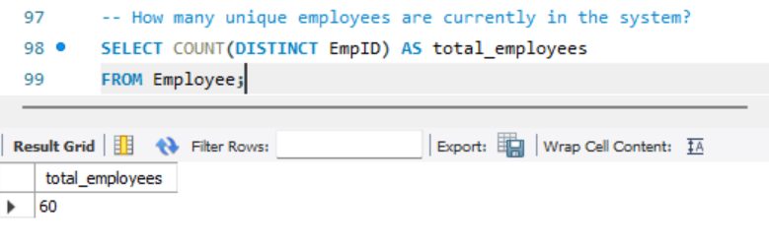
QUERIES
EMPLOYEE INSIGHTS
1.How many unique employees are currently in the system?

Slide 10
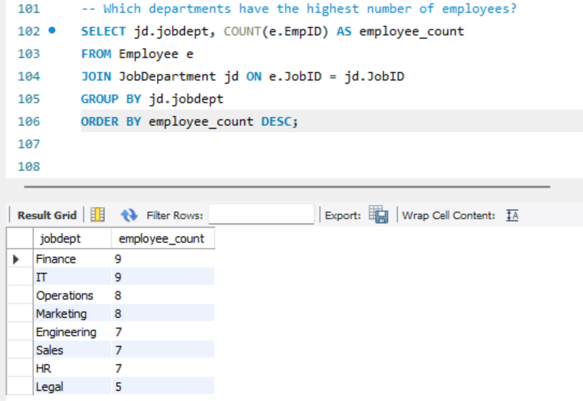
QUERIES
2.Which departments have the highest number of employees?

Slide 11
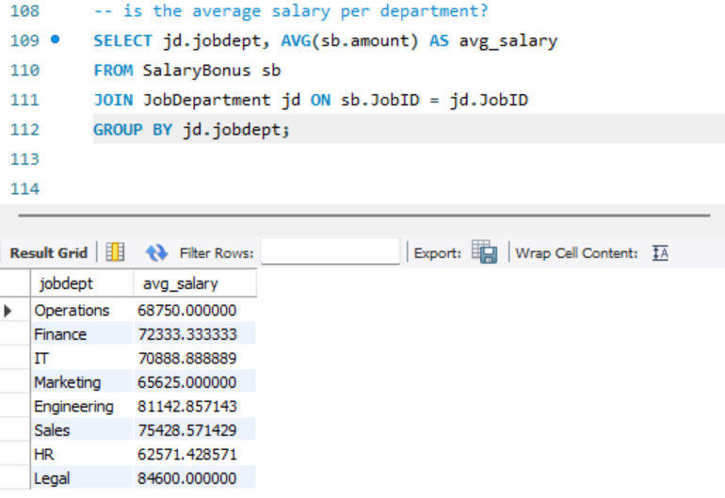
QUERIES
3.What is the average salary per department?

Slide 12
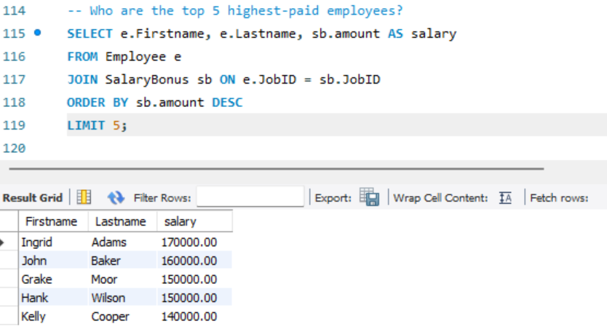
QUERIES
4. Who are the top 5 highest-paid employees?

Slide 13
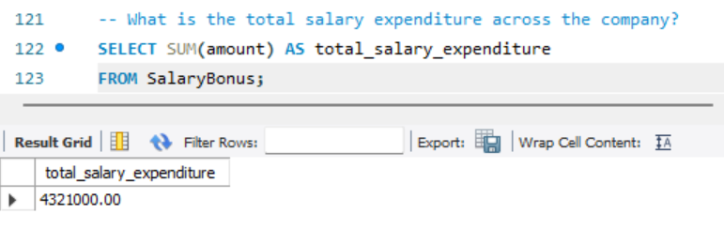
QUERIES
5. What is the total salary expenditure across the company?

Slide 14
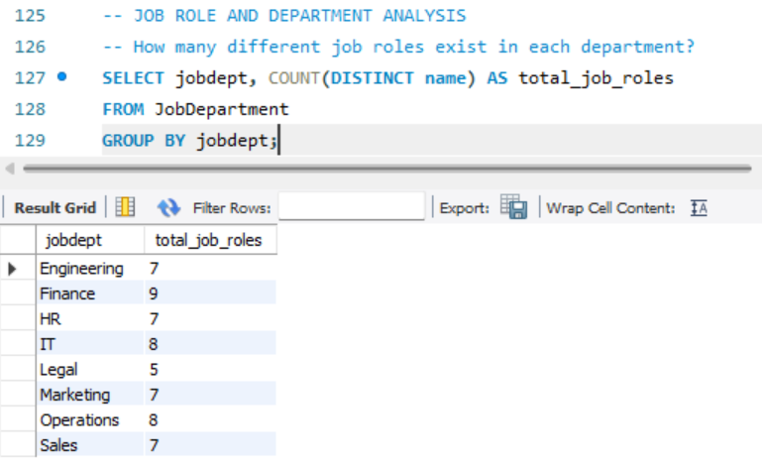
QUERIES
6. How many different job roles exist in each department?

Slide 15
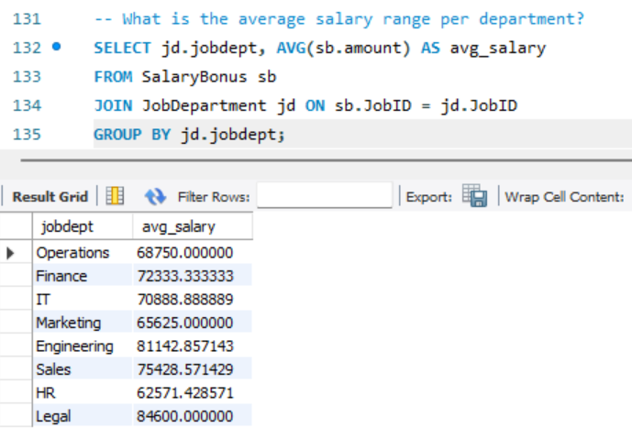
QUERIES
7. What is the average salary range per department?

Slide 16
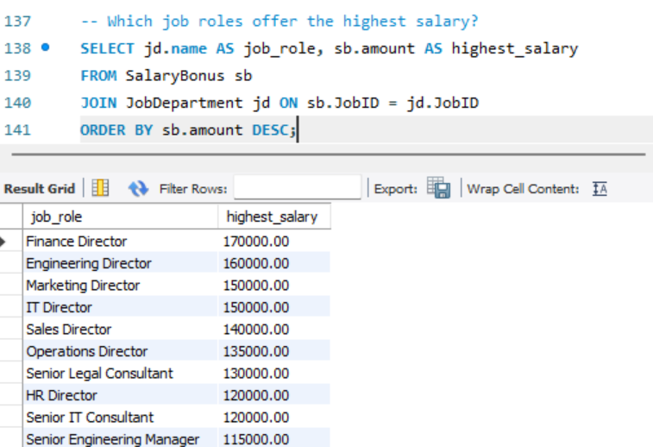
QUERIES
8. Which job roles offer the highest salary?

Slide 17
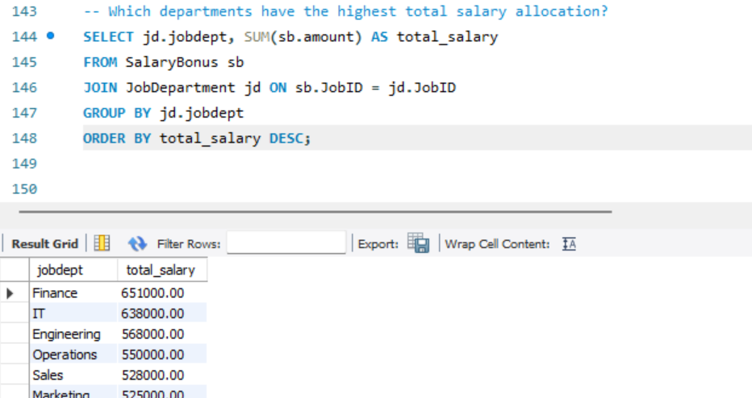
QUERIES
9. Which departments have the highest total salary allocation?

Slide 18
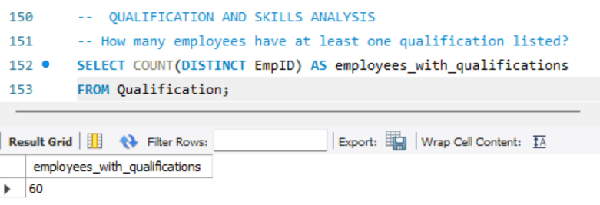
QUERIES
10. How many employees have at least one qualification listed?

Slide 19
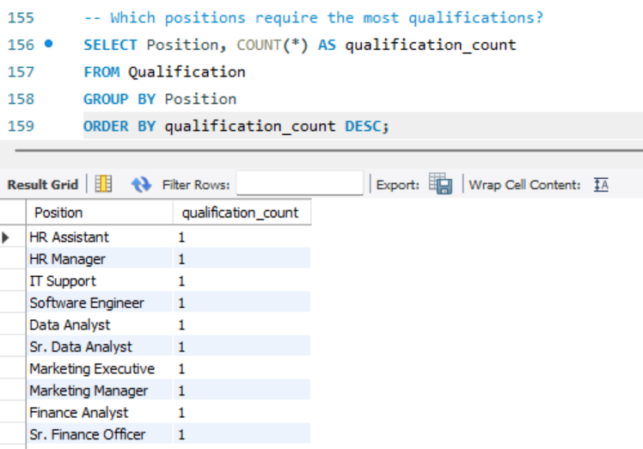
QUERIES
11. Which positions require the most qualifications?

Slide 20
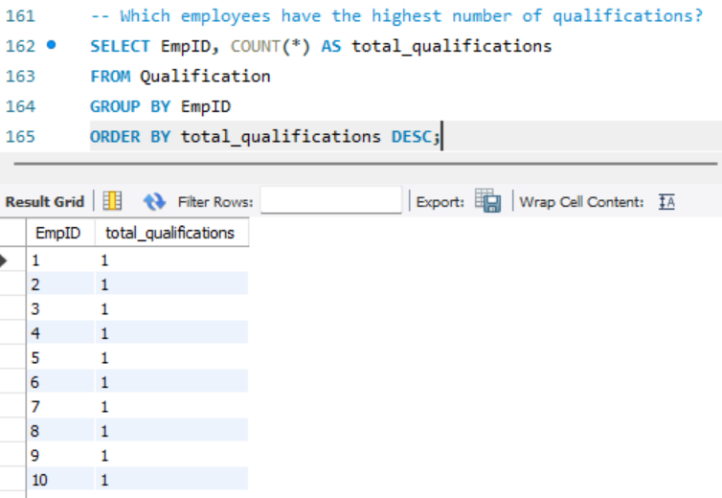
QUERIES
12. Which employees have the highest number of qualifications?

Slide 21
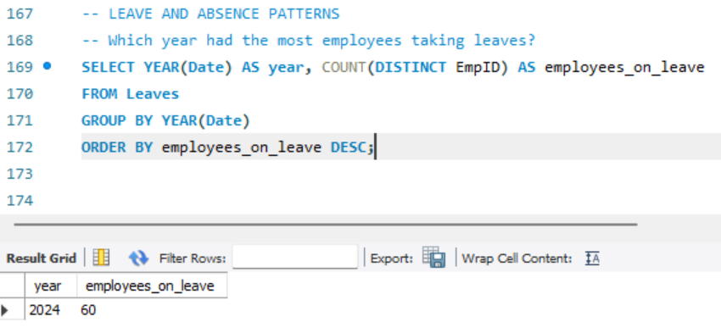
QUERIES
13. Which year had the most employees taking leaves?

Slide 22
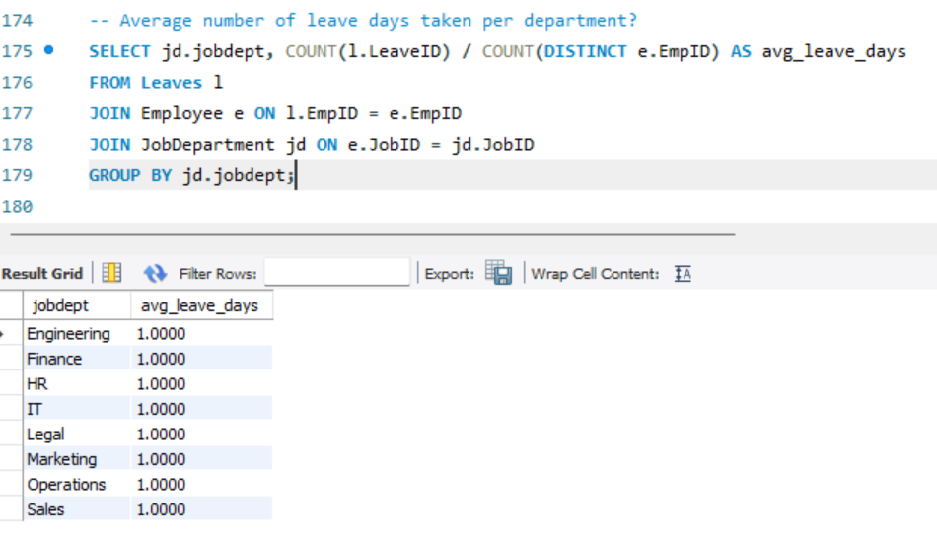
QUERIES
14. What is the average number of leave days taken by its employees per department?

Slide 23
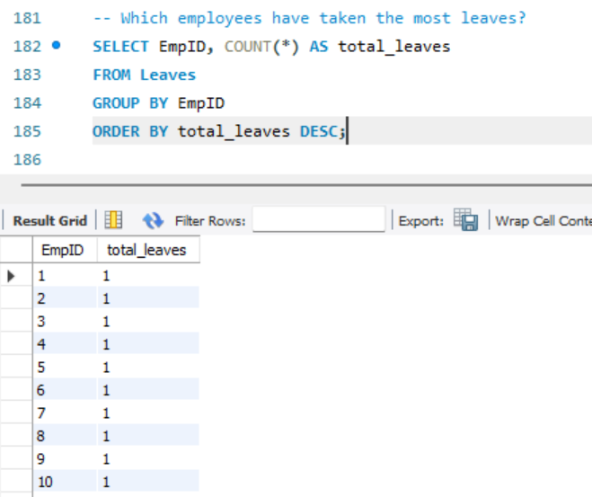
QUERIES
15. Which employees have taken the most leaves?

Slide 24
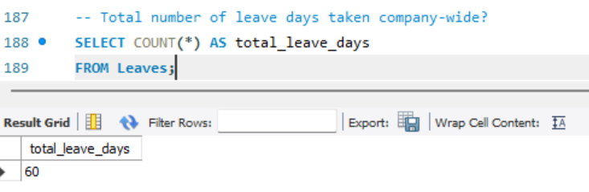
QUERIES
16. What is the total number of leave days taken company-wide?

Slide 25
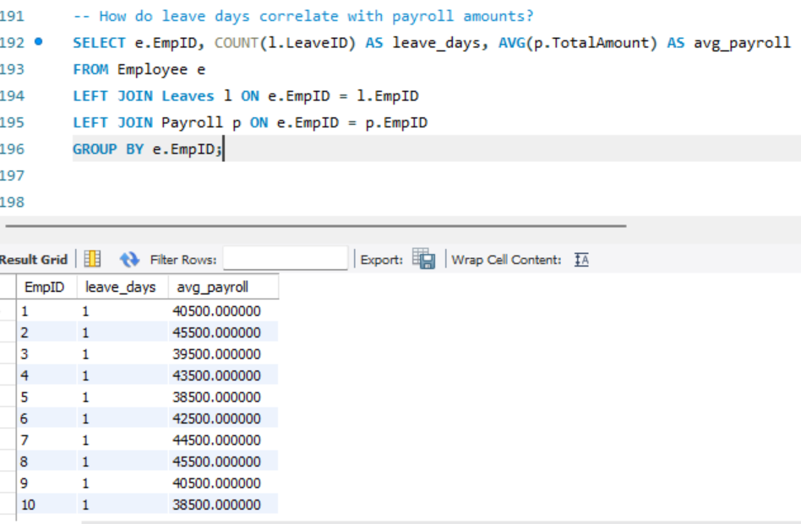
QUERIES
17. How do leave days correlate with payroll amounts?

Slide 26
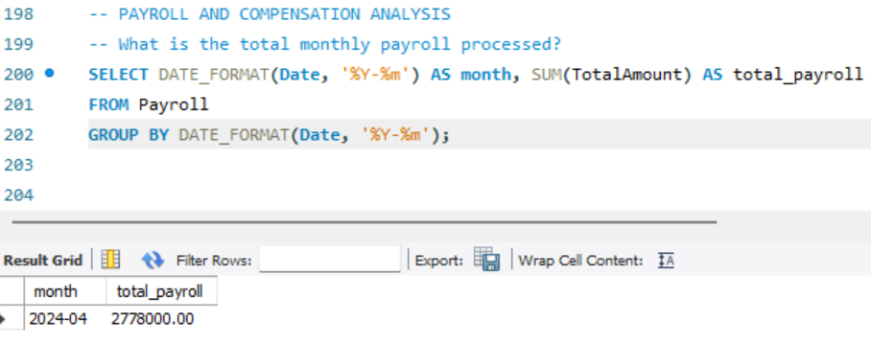
QUERIES
18.What is the total monthly payroll processed?

Slide 27
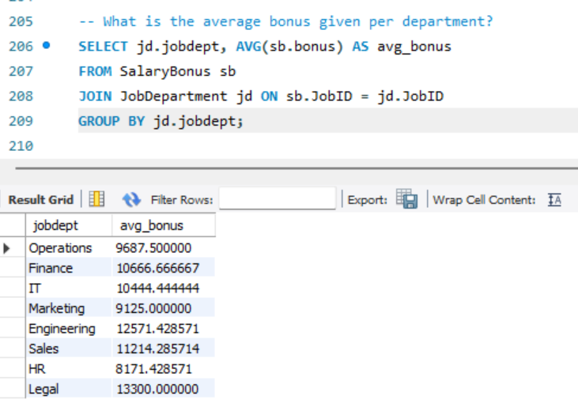
QUERIES
19. What is the average bonus given per department?

Slide 28
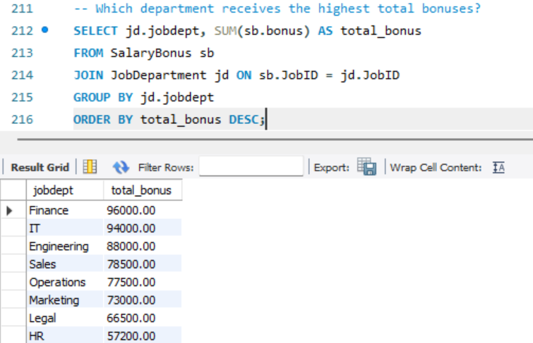
QUERIES
20. Which department receives the highest total bonuses?

Slide 29
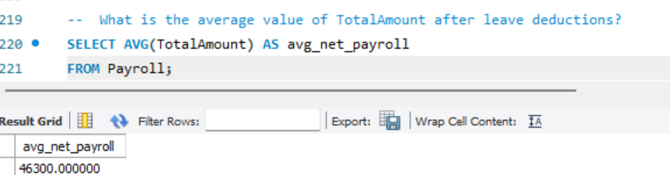
QUERIES
21. What is the average value of total_amount after considering leave deductions?

Slide 30
CONCLUSION
This project successfully demonstrates the design and implementation of a comprehensive Employee Management System using a well-structured dataset. By integrating employee details, job roles, departments, qualifications, salary structures, payroll records, and leave information, the system ensures efficient data organization and integrity. The ER diagram clearly defines relationships between entities, enabling accurate payroll processing, effective leave tracking, and streamlined HR operations. Overall, the dataset supports reliable data analysis and informed decision-making, making it suitable for real-world organizational management and academic learning purposes.

Slide 31
THANK YOU!

